Slide 1
IFACE FACIAL EXPRESSION
LVIV DATA SCIENCE SUMMER SCHOOL 2016
Marta
Alex
Jelica
Anastasia
MAJA Team
Supervisor : Oleksandr Baiev

Slide 2
Agenda
Problem description
Solution(s)
Application
Desktop
IPhone

Slide 3













Problem description
Detection of emotions
Angry
Disgust
Fear
Happy
Sad
Surprise
Neutral
Dataset
Grayscale image 48x48
Training set - 28 709
Test set - 7178

Slide 4
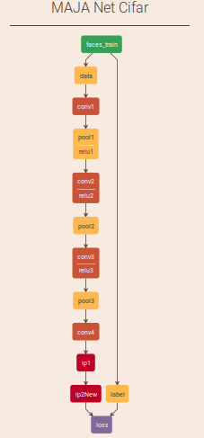
Solution(s)
UCU NET
Our design
Experiments with different parameters
Experiments with different designs
Convolutional neural network
A lot of experiments
1. UCU NET
Accurancy
Iter: 4 000
0.24
CPU ~ 2h
+ Conv
0.24
Iter: 40 000
0.39
GPU ~ 20 min

Slide 5
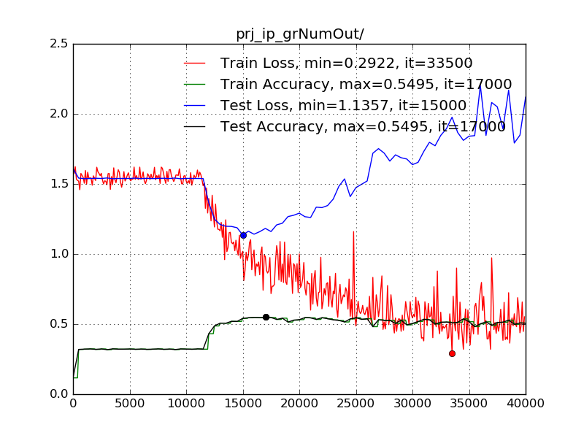
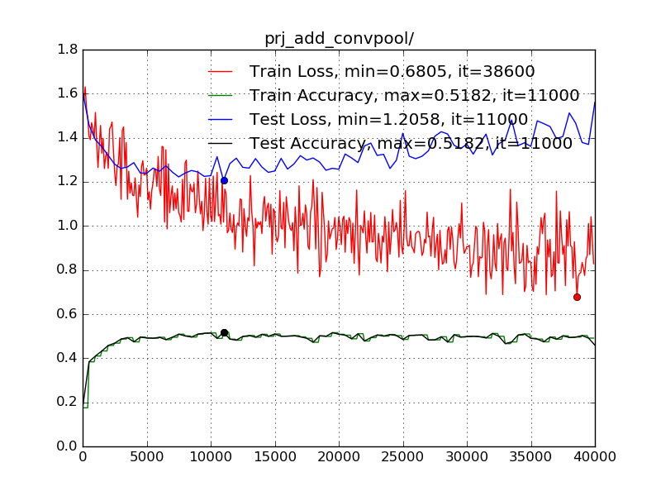
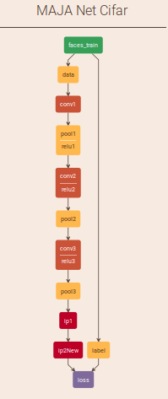
Solution(s)
2. CIFAR-10 Model
0.44
Img size 32
Transfer learning
0.44
Img size 48
0.50
Red.to 5 classes
More than 20 experiments
0.58
add layers
0.56
Change LR
Dropout layers
0.5
0.54
Mirror + Crop
0.66 !!! ☺

Slide 6
Application - desktop
Face recognition
Find emotion using our network
Draw emotion

Slide 7
Application – desktop Demo

Slide 8
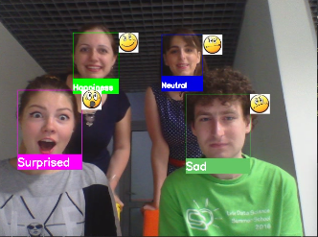
Our team
MAJA Team
Marta
Alex
Jelica
Anastasia

Slide 9
Questions ?

Slide 10
IFACE FACIAL EXPRESSION
LVIV DATA SCIENCE SUMMER SCHOOL 2016
Marta
Alex
Jelica
Anastasia
MAJA Team
Supervisor : Oleksandr Baiev

